Slide 1
Lecture 4 – Supplement -Cryptographic Algorithms and Protocols
Huang, Xiujie (黄秀姐)
Office: Nanhai Building, #411
E-mail: t_xiujie@jnu.edu.cn
Dept. Computer Science

Slide 2
Modern Symmetric-Key Cryptography
Stream Ciphers
Block Ciphers
SKC

Slide 3
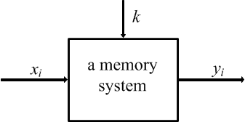
Stream Ciphers
z_{i} is from a keystream generated by the function g

Slide 4
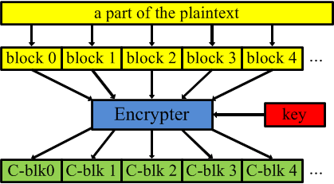
Block Ciphers

Slide 5
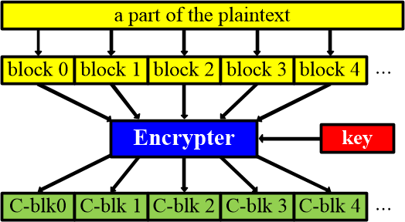
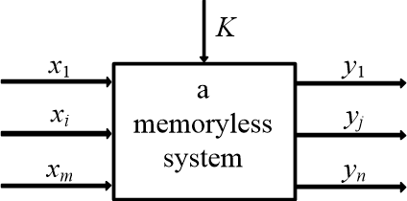
Intuition of Block Ciphers
for each block
y=e_{K}(x)

Slide 6
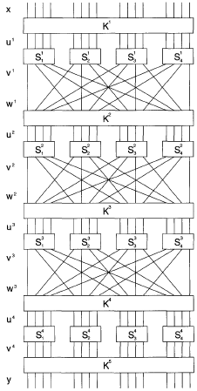
SPN
Substitutions
An example of Substitution-Permutation Network (SPN):
permutation
Substitutions
permutation
Substitutions
permutation
Substitutions

Slide 7
Cryptanalysis on SPN
Linear Cryptanalysis：See 4.3
A known plaintext attack: (x1,y2),(x2, y2), ….
To find a linear relationship between a subset of plaintext bits and a subset of state bits immediately preceding the substitutions performed in the last round
To decrypt a given ciphertext using all possible candidate keys for the last round
Differential Cryptanalysis: See 4.4
A chosen-plaintext attack:
(x1,y2),(x2, y2), …. with a fixed x’ =x1+x2
To compare the x-or of two inputs to the x-or of two outputs
To decrypt y1 and y2 from the last round

Slide 8
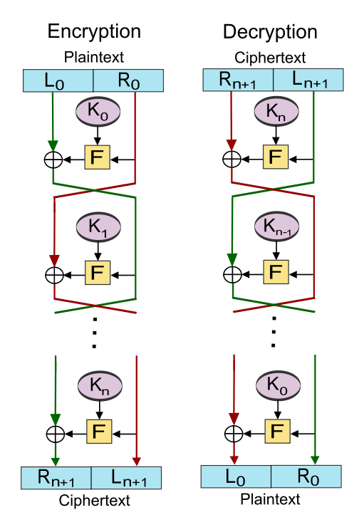
DES: core idea - Feistel Cipher
Horst Feistel (1915-1990): German-born physicist and cryptographer, who did pioneering research while working for IBM (USA)
Early 1970s
Each state is divided into two halves of equal length;
Round function:
L₁
R₁

Slide 9
DES: Key Schedule Generation
K 56bits
K=(k₁k₂k₃…k₅₆)
Add check bits
E 64bits
Permutation 1
C0 28bits
D0 28bits
Left shift 1
Left shift 1
C1 28bits
D1 28bits
Permutation 2
K¹ 48bits
Left shift 2
Left shift 2
C2 28bits
D2 28bits
Permutation 2
K² 48bits
Left shift 3
Left shift 3
C3 28bits
D3 28bits
Left shift 16
Left shift 16
C16 28bits
D16 28bits
Permutation 2
K¹⁶ 48bits

Slide 10
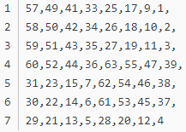

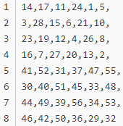

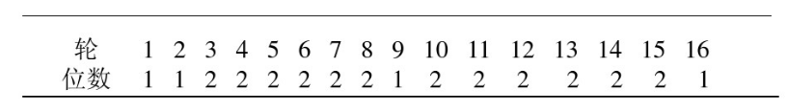
DES: Key Schedule Generation
Add check bits
K 56bits
K=(k₁k₂k₃…k₅₆)
1 | 1,2,3,4,5,6,7, | r1
2 | 8,9,10,11,12,13,14, | r2
3 | 15,16,17,18,19,20,21, | r3
4 | 22,23,24,25,26,27,28, | r4
5 | 29,30,31,32,33,34,35, | r5
6 | 36,37,38,39,40,41,42, | r6
7 | 43,44,45,46,47,48,49, | r7
8 | 50,51,52,53,54,55,56 | r8
Permutation 1
Add check bits
E 64bits
Permutation 1
C0 28bits
D0 28bits
Left shift 1
Left shift 1
C1 28bits
D1 28bits
C0 28bits
Permutation 2
K¹ 48bits
Permutation 2
Left shift 2
Left shift 2
C2 28bits
D2 28bits
D0 28bits
Permutation 2
K² 48bits
Left shift 3
Left shift 3
C3 28bits
D3 28bits
Left shift 16
Left shift 16
round
#of LS positions
C16 28bits
D16 28bits
Permutation 2
K¹⁶ 48bits
Notes:
Reference: https://blog.csdn.net/qq_27570955/article/details/52442092

Slide 11
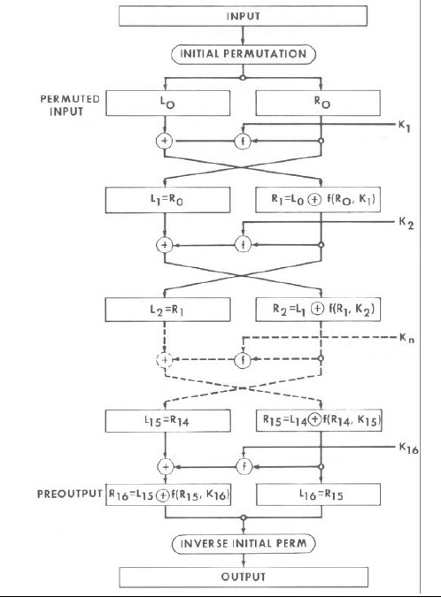
DES: Overview from FIPS 46-3

Slide 12

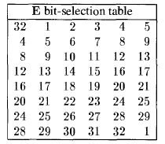
DES：Expansion E (32 bits→48 bits)

Slide 13
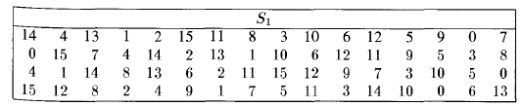
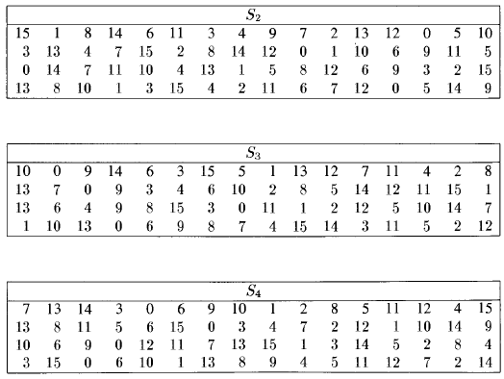
DES: S-boxes (I)

Slide 14
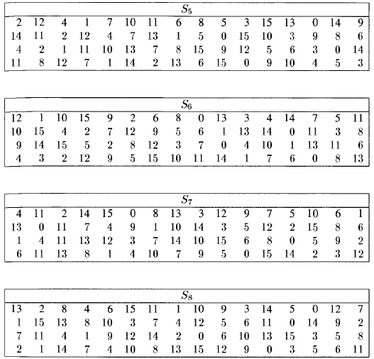
DES: S-boxes (II)

Slide 15

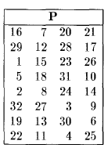
DES: Permutation P

Slide 16
Introduction of AES
1. Jan. 2, 1997, NIST, beginning, replacement of DES
Called AES
2. Sept. 12, 1997, NIST, a formal call
Blocks: 128-bits; keys: 128-bits, 192-bits, 256-bits
3. June 5,1998: 21 cryptosystems from 12 countries were submitted
15 met and were accepted as AES candidates
4. Aug. 20, 1998, First AES Candidate Conference
the 15 ciphers were announced
5. March 1999, Second AES Candidate Conference
6. Aug. 1999, Five Candidates were chosen by NIST
MARS, RC6, Rijndael, Serpend and Twofish
7. April 2000, Third AES Candidate Conference
8. Oct. 2, 2000, Rijndael was selected to be the AES
9. Nov. 26, 2001, AES was adopted as a standard

Slide 17
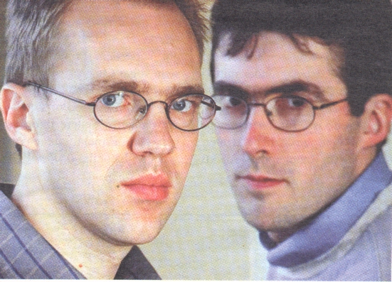
AES: Inventors
Joan Daemen and Vincent Rijmen

Slide 18
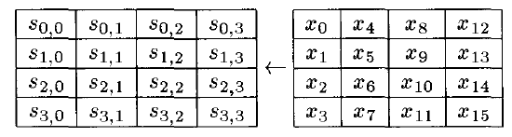
AES: State
plaintext x:
128 bits = 16 bytes:
Each byte consists of two hexadecimal (十六进制) digits
State: a 4x4 array of bytes
Initial State:
position
content

Slide 19

AES: SUBBYTES (1/3)
A substitution on each byte of State independently
: {0,1}⁸ → {0,1}⁸
= ZW
in hexadecimal notation

Slide 20
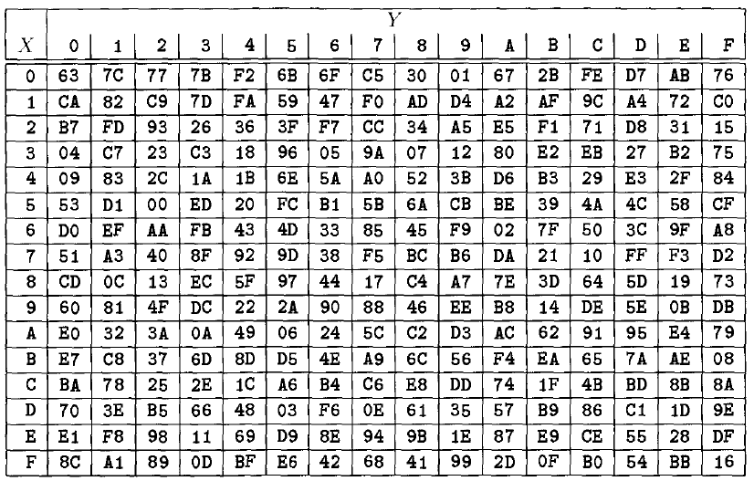
AES: SUBBYTES (2/3)
The array representation of the substitution (Figure 3.8 on Page 106)
= ZW

Slide 21
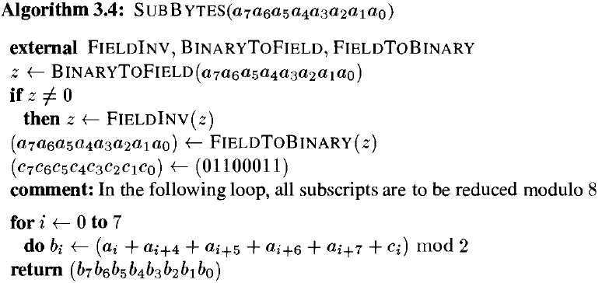
AES: SUBBYTES (3/3)
Two representations of the substitution :
The array representation (S-box)
The algebraic formulation

Slide 22
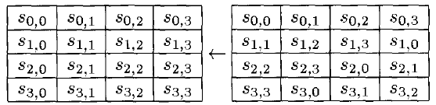
AES: SHIFTROWS
position
content

Slide 23
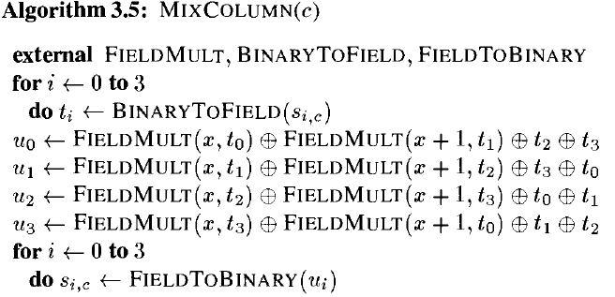
AES: MIXCOLUMNS
An operation on each of the four columns of State
c=0
c=3

Slide 24


Introduction to the Finite Field
The Finite Field of 256 elements is denoted by :
→ A(x)
Multiplicative inverse: B(x) such that A(x)∙B(x) = 1 mod ( )
See Example 4.4 on Pages 112-113
See Example 7.7 on Pages 274-275

Slide 25
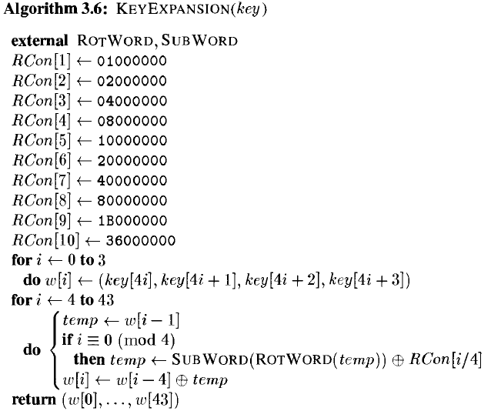
AES: KEYEXPANSION
Keylength:128 bits; Rounds: Nr=10; 11 round Keys
word-oriented operations:
128 bits (= 16 bytes = 4 words )

Slide 26
Introduction to Modes of Operation
for a plaintext block
for a long sequence of plaintext blocks
A plaintext x
Key K
A block cipher encryptor
How to use the block cipher encryptor to encrypt a long sequence of plaintexts?
A ciphertext y
y=e_{K}(x)
Modes of operation
DES or AES

Slide 27
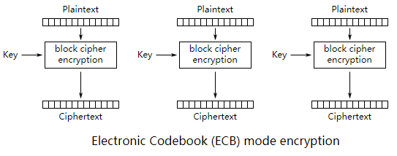
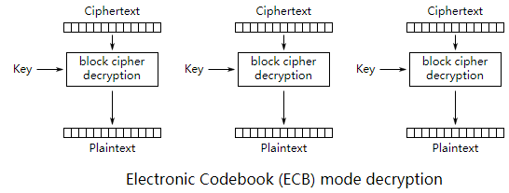


ECB: DES & AES
$$y_{i}=e_{K}(x_{i})$$
$$x_{i}=d_{K}(y_{i})$$

Slide 28
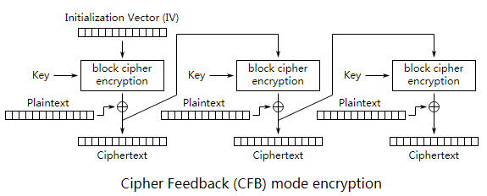
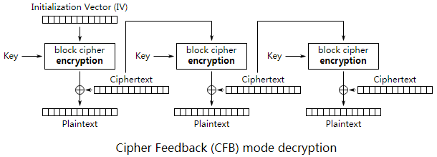
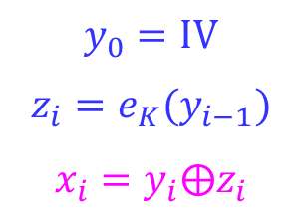
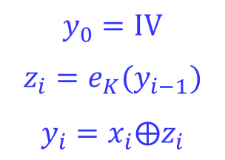
CFB: DES & AES
$$y_{0}=IV$$
$$z_{i}=e_{K}(y_{i−1})$$
$$y_{i}=x_{i}⨁z_{i}$$
$$y_{0}=IV$$
$$z_{i}=e_{K}(y_{i−1})$$
$$x_{i}=y_{i}⨁z_{i}$$

Slide 29
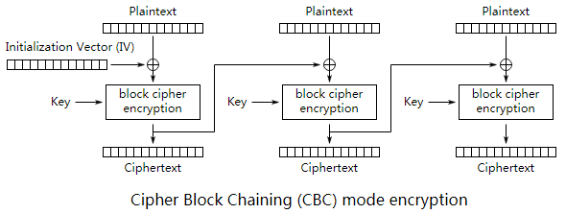
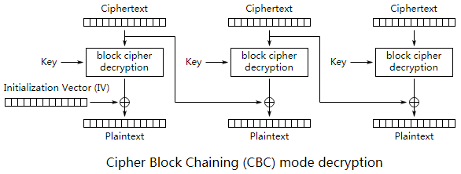
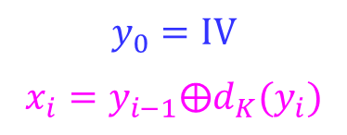
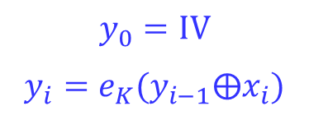
CBC: DES & AES
$$y_{0}=IV$$
$$y_{i}=e_{K}(y_{i−1}⨁x_{i})$$
$$y_{0}=IV$$
$$x_{i}=y_{i−1}⨁d_{K}(y_{i})$$

Slide 30
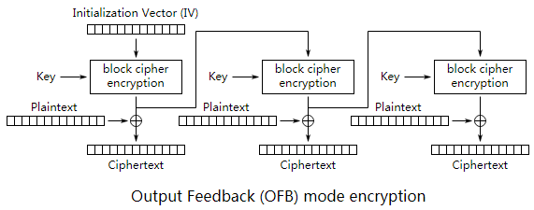
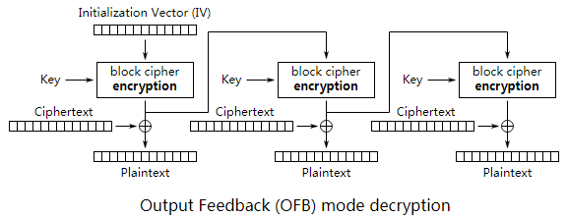
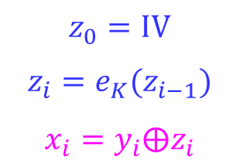
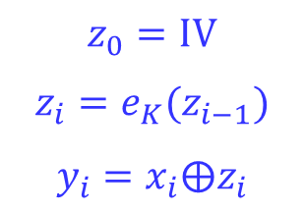
OFB: DES & AES
$$z_{0}=IV$$
$$z_{i}=e_{K}(z_{i−1})$$
$$y_{i}=x_{i}⨁z_{i}$$
$$z_{0}=IV$$
$$z_{i}=e_{K}(z_{i−1})$$
$$x_{i}=y_{i}⨁z_{i}$$

Slide 31
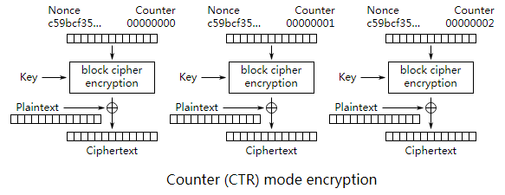
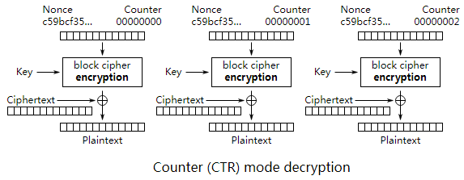
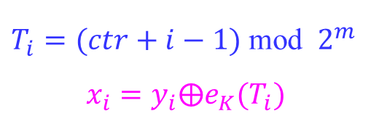
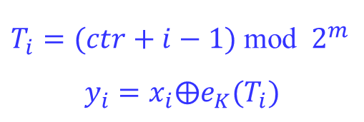
CTR (Counter) Mode: AES
$T_{i}=(ctr+i−1)$ mod $2^{m}$
$$y_{i}=x_{i}⨁e_{K}(T_{i})$$
$T_{i}=(ctr+i−1)$ mod $2^{m}$
$$x_{i}=y_{i}⨁e_{K}(T_{i})$$

Slide 32
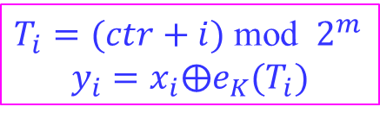
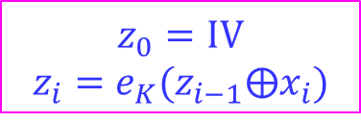


CCM: AES
CCM mode combines the use of counter mode (for encryption) with CBC-mode (for authentication)
CBC mode:
CTR mode:
See Section 5.5.3
$$z_{0}=IV$$
$$z_{i}=e_{K}(z_{i−1}⨁x_{i})$$
$T_{i}=(ctr+i)$ mod $2^{m}$
$$y_{i}=x_{i}⨁e_{K}(T_{i})$$
$$y^{′}=T_{0}⨁z_{n}$$
$$y=y_{1}∥y_{2}∥⋯∥y_{n}∥y′$$

Slide 33
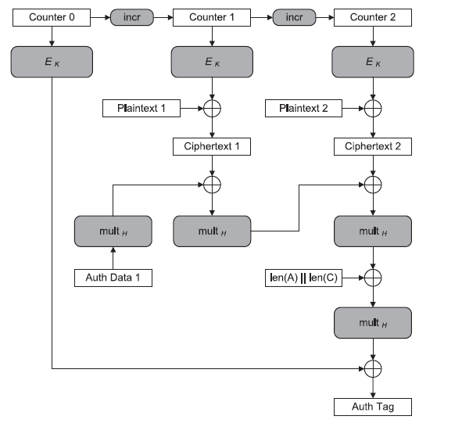
GCM: AES
CCM mode, be used for authentication encryption
See Section 5.5.3

Slide 34
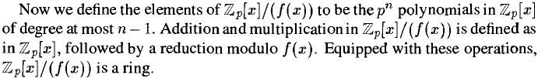

Introduction to the Finite Field
Quotient Ring: = {g(x) mod f(x): g(x) is in }
= {a_{n-1} x^{n-1} + … + a₂ x² + a₁x + a₀: a_{i} in }

Slide 35
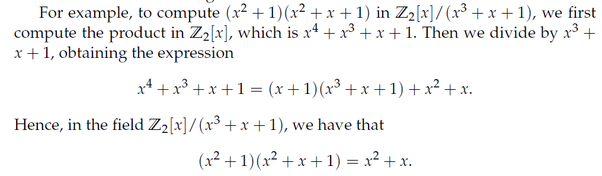
Introduction to the Finite Field
Order: 2^{n}
F₂[x]/(f(x)): f(x) is irreducible and deg(f) = n
a_{n-1} x^{n-1} + … + a₂ x² + a₁x + a₀
←→ (a_{n-1} … a₂ a₁a₀)
See Examples on Pages 273-274

Slide 36
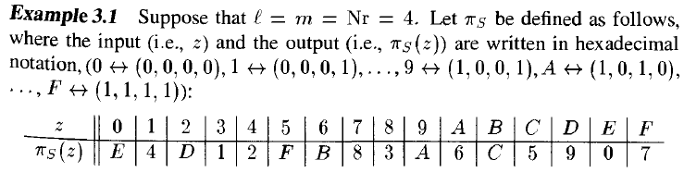

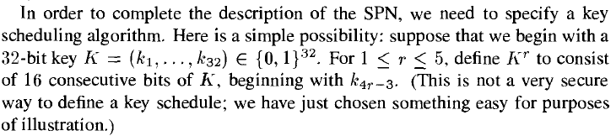

Example 3.1

Slide 37
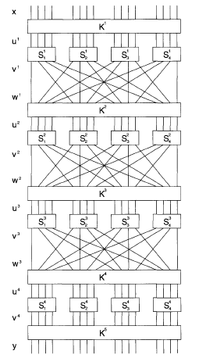
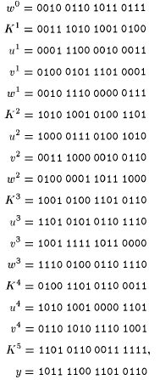
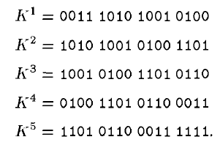
Example 3.1

Slide 38


Stream Ciphers

Slide 39

Binary Steam Ciphers
LFSR:
c₀
c₁
c₂
c_{j-1}
c_{m-1}
k₁
k₂
k₃
k_{j}
k_{m}
z₁z₂z₃……
g:

Slide 40


Known-plaintext attack on the LFSR Stream cipher
Encryption rule:
Keystream generator:
KEY?
(k₁, k₂, …, k_{m}) = (z₁, z₂, …, z_{m})

Slide 41


Known-plaintext attack on the LFSR Stream cipher
?

Slide 42
Practical Stream Ciphers
the idea of LFSR is still used:
Efficiency (in software and hardware)
Large period
Three of the most common methods of generating keystream
Combination generator
Filter generator
Shrinking generator
Cryptanalysis:
Correlation attack on a combination generator
Algebraic attack on a filter generator

Slide 43

Combination generator
Correlation Attack on a Combination Generator

Slide 44

Filter generator
Algebraic Attack on a Filter Generator

Slide 45

Shrinking generator

Slide 46
Applications of Stream Ciphers
Some already broken but still used stream ciphers：
1. CSS (Content Scramble System)(2 LFSRs): DVD encryption 用于加密DVD的内容扰乱系统
2. A5 (3 LFSRs): GSM encryption
3. E0 (4 LFSRs): Bluetooth encryption
4. RC4:
designed by Ron Rivest in 1987, revealed anonymously in 1994
Used in HTTPS, WEP (IEEE 801.11), WAP, SQL Database

Slide 47
Applications of Stream Ciphers
Some modern stream ciphers：
1. SEAL (8 LFSRs):
designed by Rogaway & Coppermfith in IBM in 1994
Suitable in software
2. Salsa20:
From eStream Project (2005-2008)
Suitable both in software and hardware
https://www.ecrypt.eu.org/stream/e2-salsa20.html
3. Trivium:
Designed by De Canniere and Preneel in 2005
From eStream Project (2005-2008)
https://www.ecrypt.eu.org/stream/e2-trivium.html

Slide 48



Applications of Stream Ciphers
3. Trivium:
Efficient and secure against known attacks
Key size: 80 bits; IV size: 80 bits; Internal state: 288 bits (93+84+111)
Three registers A , B, C
A
B
C
r_{i}
key stream

Slide 49
The Stream Cipher is an Interesting Topic!
Design keystream generator g:
Randomicity of the keystream: sequence design
Efficiency;
Large period (> 10¹⁶bit);
……
Cryptanalysis:
Evaluation criteria for security;
Attack methods;
……
Some examples of research on stream ciphers:
P. Yadav, I. Gupta, S.K. Murthy, “Study and analysis of eSTREAM cipher Salsa and ChaCha”, IEEE ICETECH 2016
Lin Ding, “Improved Related-Cipher Attack on Salsa20 Stream Cipher”, IEEE ACCESS, 2019

Slide 50
Group Work on Stream Cipher
Some already broken but still used stream ciphers.
1. What is CSS? Cryptanalysis on CSS.
2. What is A5? Cryptanalysis on A5.
3. What is E0? Cryptanalysis on E0.
4. What is RC4? Cryptanalysis on RC4.
Group work:
8 groups;
each group 3-4 persons;
personal contribution;
Due to 03/31/2022.

Slide 51



4.3 DES: core idea
K 56bits
K=(k₁k₂k₃…k₅₆)
Add check bits
E 64bits
Permutation 1
C0 28bits
D0 28bits
Left shift 1
Left shift 1
C1 28bits
D1 28bits
Permutation 2
Left shift 2
Left shift 2
K¹ 48bits
C2 28bits
D2 28bits
Permutation 2
Left shift 3
Left shift 3
K² 48bits
C3 28bits
D3 28bits
Left shift 16
Left shift 16
C16 28bits
D16 28bits
Permutation 2
K¹⁶ 48bits

Slide 52


4.6 CBC
$$y_{0}=IV$$
$$x_{i}=y_{i−1}⨁d_{K}(y_{i})$$
4.8 CFB
$$y_{0}=IV$$
$$z_{i}=e_{K}(y_{i−1})$$
$$y_{i}=x_{i}⨁z_{i}$$

Slide 53
4.9 OFB:
$$z_{0}=IV$$
$$z_{i}=e_{K}(z_{i−1})$$
$$y_{i}=x_{i}⨁z_{i}$$

